Slide 1
COURSE : OBJECT ORIENTED PROGRAMMING
COURSE INSPECTOR : N.VENKATA RAMANA SIR
TITLE OF THE PROJECT : COLLAGE MANAGEMENT SYSTEM
LIST OF DEVELOPERS : M.DEEKSHITHA
A.SOMINI
V.SRUJITHA
CH.LOUKYA
R.LAKSHMI PRASANNA
A.HARSHA VARDHINI
SK.AMISHA
K.VARSHA
CH.JAHNAVI
I.VYSHNAVI

Slide 2
BRIEF ON PROJECT :
Digital transformation is the new reality of this modern world.
Besides industries such as manufacturing, corporates, banking, and commerce, the education domain has new challenges and its of paramount importance to address the evolving needs of this domain.
The college management system helps Educational Institutions especially colleges in various ways, such as storing data, maintaining student profiles, analyzing administrative and academic data, improving communication, and engaging students.
There are several college ERP software’s that’s available in the market to streamline administrative processes.
The world is rapidly changing and technology has to meet the expectations of the new age learners.
Students of this generation rely on technology to update themselves on a regular basis.
Giving them a seamless experience of transitioning from the real to the digital world and vice versa is imperative.

Slide 3
FEATURES OF COLLAGE MANAGEMENT SYSTEM :
Admission and Marketing.
Student fees management.
Student Attendance and Management System.
Student Behaviour and Discipline Tracking.
Time Table Management.
Examination Management.
Gradebook Management.
Placement Management.
Transport Management Software.

Slide 4

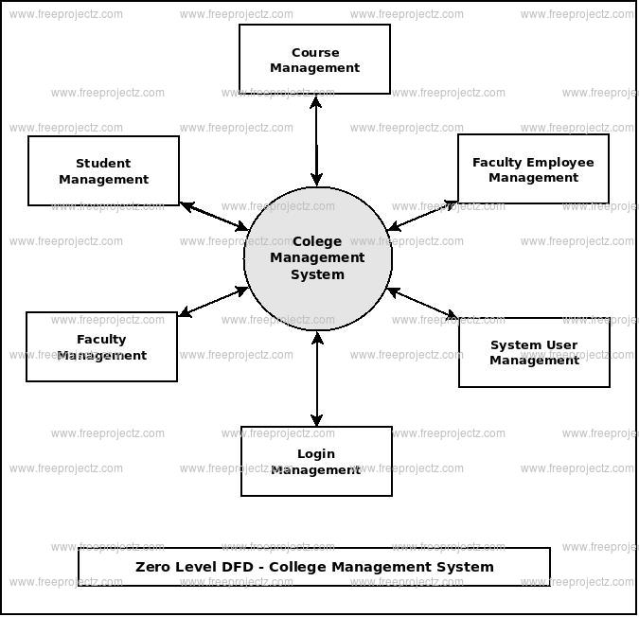

Slide 6
INTERFACES(OR)ABSTRATIONS IN HOSPITAL MANGAEMENT:
College management is when a group of people and resources work together to plan, organize, strategize, and put in place structures to run an educational system.
The college management system oversees enrollment, admissions, students, faculty, attendance, fees, scheduling, assignments, grades, and the Institution as a whole.
The college management system is designed to automate all the processes included.
It generates automatic reports on all elements for data-driven decision-making.
The college information management system, in general, helps educational institutions by automating regular administrative tasks.
It’s called a “college administration system,” and it has a lot of features, like apps, student achievement assessments, and more.

Slide 7
ROLES AND RESPONSIBILITIES OF TEAM MEMBERS:
On a project team, each member has certain responsibilities or specific tasks that help contribute to the success of the project. That’s why it is important to have varying roles on the project team.

Slide 9
NOW LETS MOVE ON TO SOME QUESTION AND ANSWERS

Slide 10
THANK YOU

